Slide 1
Computer Graphics

Slide 2
Introduction to computer graphics
Computer graphics is an art of drawing pictures, lines, charts, etc. using computers with the help of programming. Computer graphics image is made up of number of pixels. Pixel is the smallest addressable graphical unit represented on the computer screen.

Slide 3
Advantages of computer graphics
Computer graphics is one of the most effective and commonly used ways of communication with
computer.
• It provides tools for producing picture of “real-world” as well as synthetic objects such as mathematical
surfaces in 4D and of data that have no inherent geometry such as survey result.
• It has ability to show moving pictures thus possible to produce animations with computer graphics.
• With the use of computer graphics we can control the animation by adjusting the speed, portion of
picture in view the amount of detail shown and so on.

Slide 4
Application of computer graphics
User interface: - Visual object which we observe on screen which communicates with user is one of the most useful applications of the computer graphics.
Plotting of graphics and chart in industry, business, government and educational organizations drawing like bars, pie-charts, histogram’s are very useful for quick and good decision making.
Office automation and desktop publishing: - It is used for creation and dissemination of information. It is used in in-house creation and printing of documents which contains text, tables, graphs and other forms of drawn or scanned images or picture.
Computer aided drafting and design: - It uses graphics to design components and system such as automobile bodies structures of building etc.

Slide 5
video-display devices
Display devices are also known as output devices.
• Most commonly used output device in a graphics system is a video monitor

Slide 6
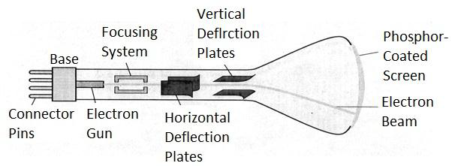
Cathode-ray-tubes
It is an evacuated glass tube.
• An electron gun at the rear of the tube produce a beam of electrons which is directed towards the screen of the tube by a high voltage typically 15000 to 20000 volts
• Inner side screen is coated with phosphor substance which gives light when it is stroked bye electrons.
• Control grid controls velocity of electrons before they hit the phosphor.
• The control grid voltage determines how many electrons are actually in the electron beam. The negative the control voltage is the fewer the electrons that pass through the grid.
• Thus control grid controls Intensity of the spot where beam strikes the screen.
• The focusing system concentrates the electron beam so it converges to small point when hits the
phosphor coating.
• Deflection system directs beam which decides the point where beam strikes the screen.
• Deflection system of the CRT consists of two pairs of parallel plates which are vertical and horizontal deflection plates.
• Voltage applied to vertical and horizontal deflection plates is control vertical and horizontal deflection respectively.

Slide 7
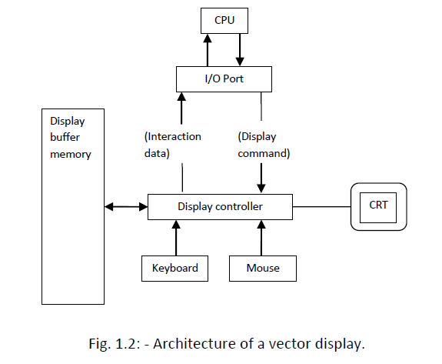
Random scan display

Slide 8
• Vector scan display directly traces out only the desired lines on CRT.
• If we want line between point p1 & p2 then we directly drive the beam deflection circuitry which focus
beam directly from point p1 to p2.
• If we do not want to display line from p1 to p2 and just move then we can blank the beam as we move it.
• To move the beam across the CRT, the information about both magnitude and direction is required. This
information is generated with the help of vector graphics generator.
• Fig. 1.2 shows architecture of vector display. It consists of display controller, CPU, display buffer memory
and CRT.
• Display controller is connected as an I/O peripheral to the CPU.
• Display buffer stores computer produced display list or display program.
• The Program contains point & line plotting commands with end point co-ordinates as well as character
plotting commands.
• Display controller interprets command and sends digital and point co-ordinates to a vector generator.
• Vector generator then converts the digital co-ordinate value to analog voltages for beam deflection
circuits that displace an electron beam which points on the CRT’s screen.
• In this technique beam is deflected from end point to end point hence this techniques is also called
random scan.
• We know as beam strikes phosphors coated screen it emits light but that light decays after few
milliseconds and therefore it is necessary to repeat through the display list to refresh the screen at least
30 times per second to avoid flicker.
• As display buffer is used to store display list and used to refreshing, it is also called refresh buffer

Slide 9
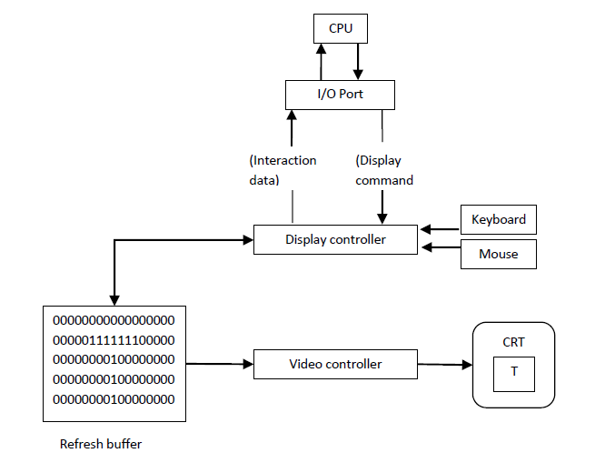
raster-scan systems

Slide 10
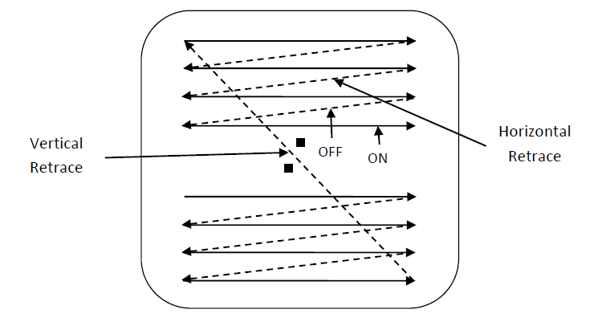
Fig. 1.3 shows the architecture of Raster display. It consists of display controller, CPU, video controller,
refresh buffer, keyboard, mouse and CRT.
• The display image is stored in the form of 1’s and 0’s in the refresh buffer.
• The video controller reads this refresh buffer and produces the actual image on screen.
• It will scan one line at a time from top to bottom & then back to the top
In this method the horizontal and vertical deflection signals are generated to move the beam all over the
screen in a pattern
• Here beam is swept back & forth from left to the right.
• When beam is moved from left to right it is ON.

Slide 11

Points and Lines
Point plotting is done by converting a single coordinate position furnished by an application program into appropriate operations for the output device in use.
Line drawing is done by calculating intermediate positions along the line path between two specified endpoint positions.
The output device is then directed to fill in those positions between the end points with some color.
For some device such as a pen plotter or random scan display, a straight line can be drawn smoothly from one end point to other.
Digital devices display a straight line segment by plotting discrete points between the two endpoints.
Discrete coordinate positions along the line path are calculated from the equation of the line.
For a raster video display, the line intensity is loaded in frame buffer at the corresponding pixel positions.
Reading from the frame buffer, the video controller then plots the screen pixels.
Screen locations are referenced with integer values, so plotted positions may only approximate actual line positions between two specified endpoints.
For example line position of (12.36, 23.87) would be converted to pixel position (12, 24).

Slide 12
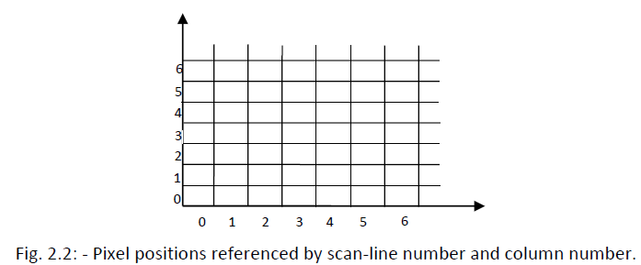
The stair step shape is noticeable in low resolution system, and we can improve their appearance
somewhat by displaying them on high resolution system.
• More effective techniques for smoothing raster lines are based on adjusting pixel intensities along the
line paths.
• For raster graphics device-level algorithms discuss here, object positions are specified directly in integer
device coordinates.
• Pixel position will referenced according to scan-line number and column number which is illustrated by
following figure.

Slide 13
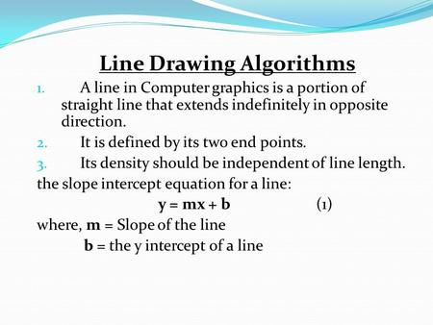

Slide 14
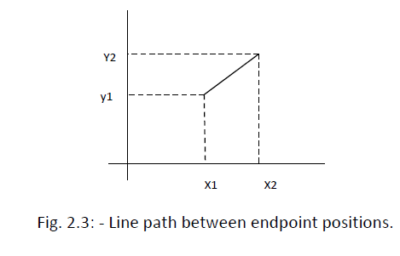
The Cartesian slop-intercept equation for a straight line is “𝑦 = 𝑚𝑥 + 𝑏” with ‘𝑚’ representing slop and ‘𝑏’ as the intercept.
• The two endpoints of the line are given which are say (𝑥1, 𝑦1) and (𝑥2, 𝑦2). We can determine values for the slope m by equation:
𝑚 = (𝑦2 − 𝑦1)/(𝑥2 − 𝑥1)
• We can determine values for the intercept b by equation:
𝑏 = 𝑦1 − 𝑚 ∗ 𝑥1
• For the given interval Δ𝑥 along a line, we can compute the corresponding 𝑦 interval Δ𝑦 as:
Δ𝑦 = 𝑚 ∗ Δ𝑥
• Similarly for Δ𝑥:
Δ𝑥 = Δ𝑦/𝑚

Slide 15
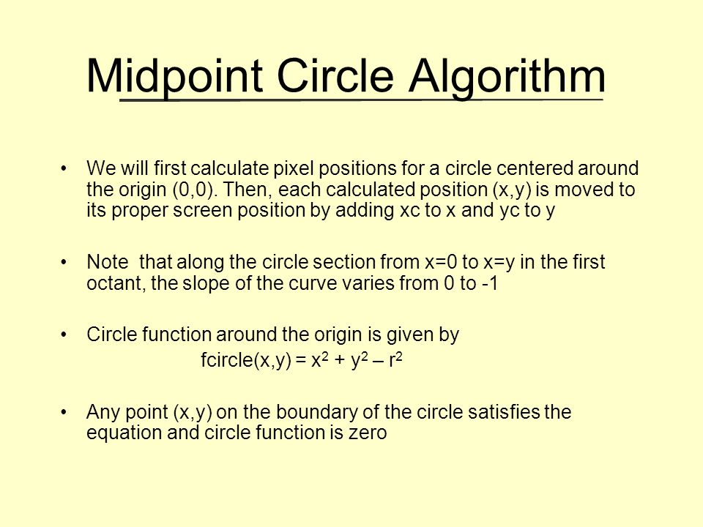

Slide 16
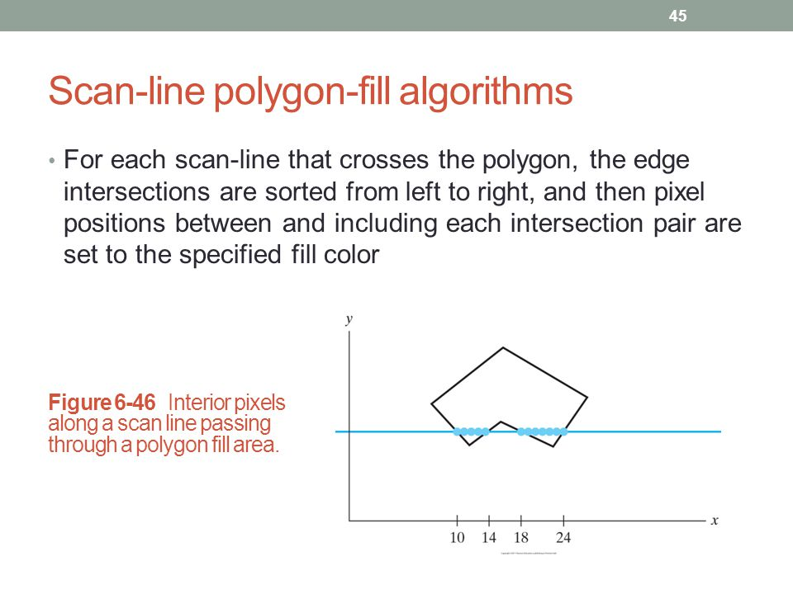

Slide 17
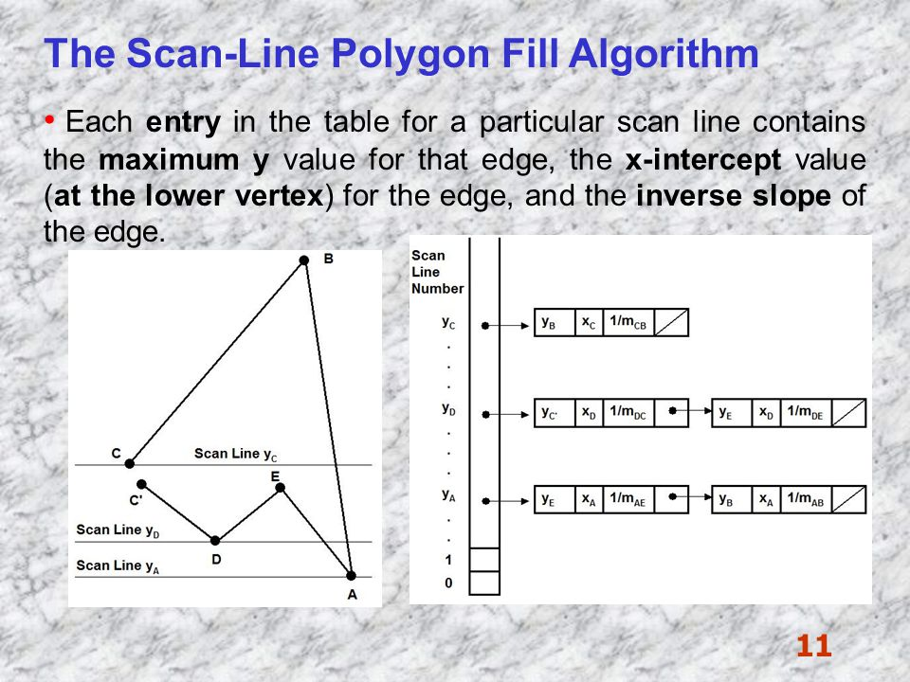

Slide 18
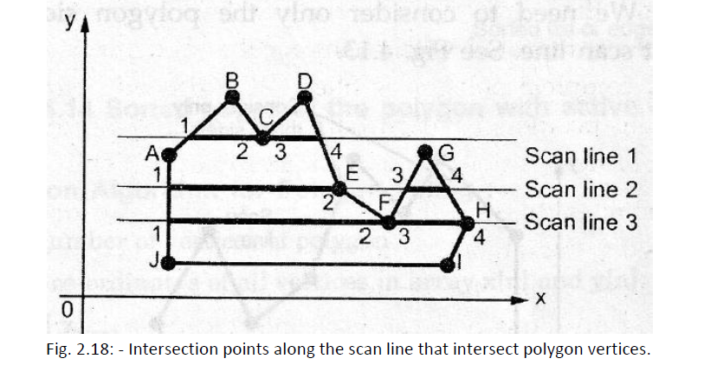

Slide 19
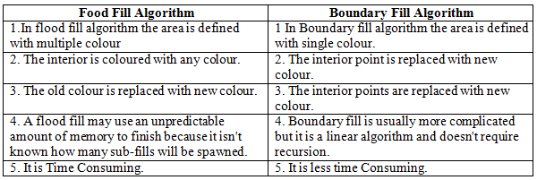

Slide 20
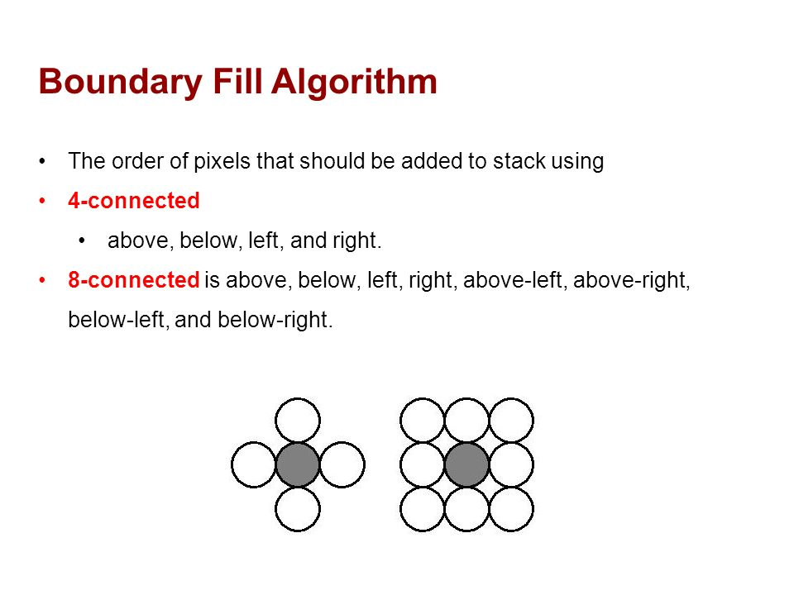

Slide 21
Unit-2

Slide 22
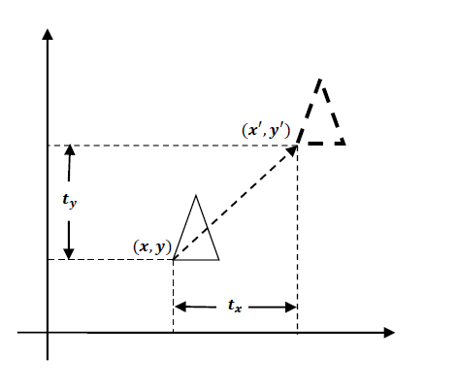
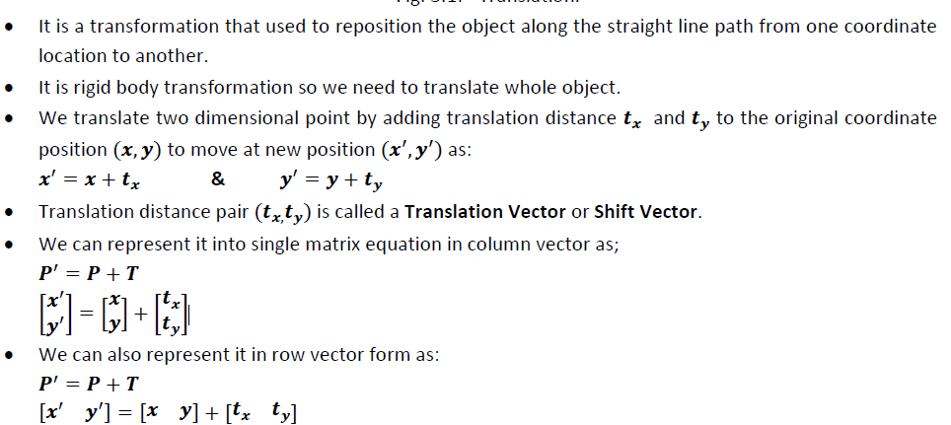
Translation

Slide 23
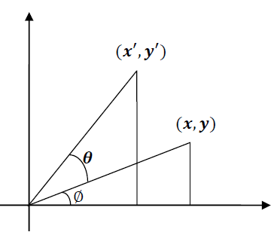
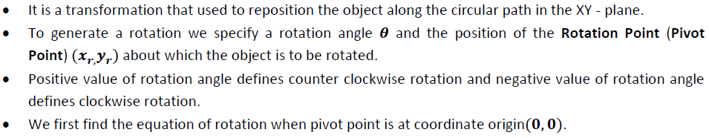
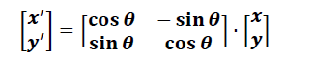
Rotation

Slide 24
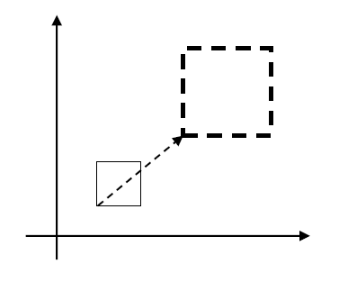
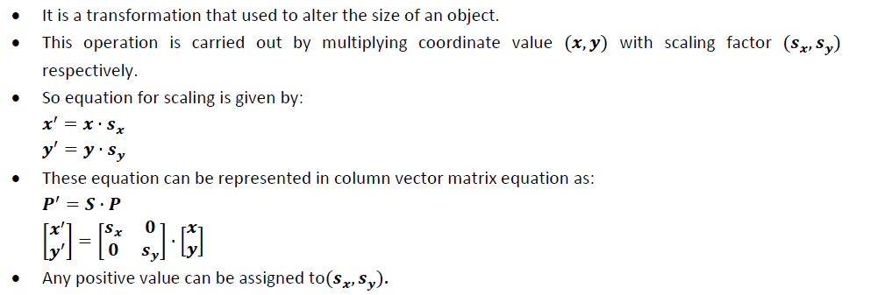
SCALING

Slide 25
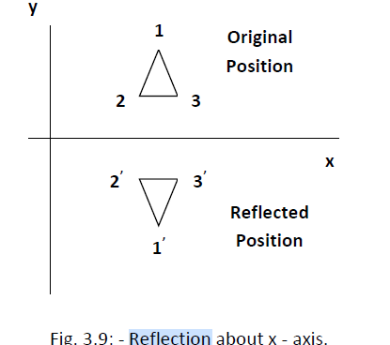
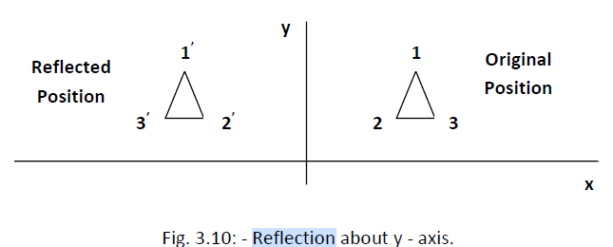
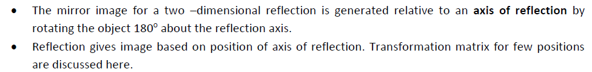
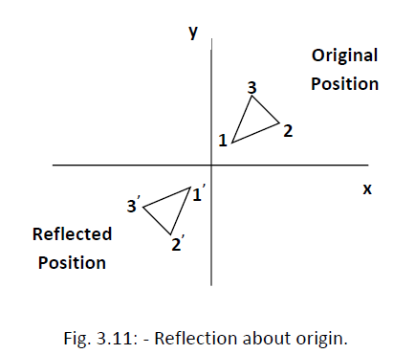
REFLECTION

Slide 26
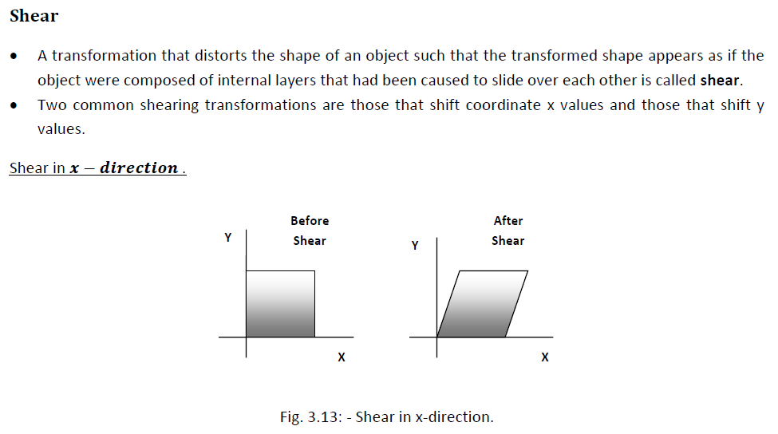

Slide 27
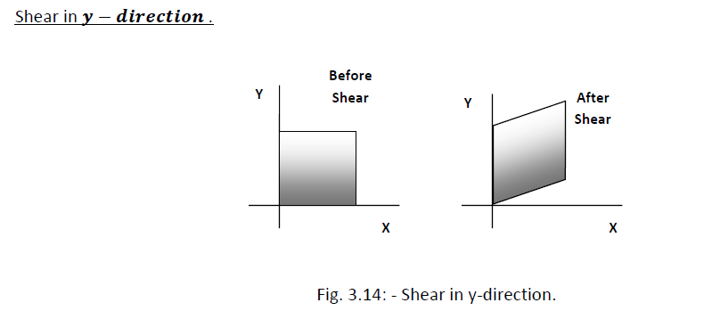

Slide 28
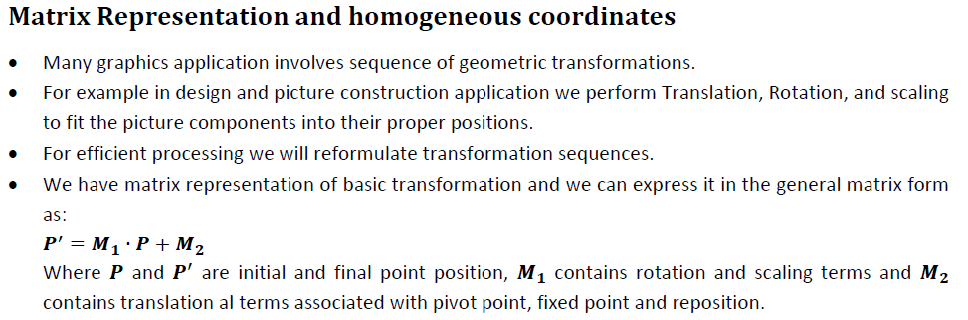

Slide 29
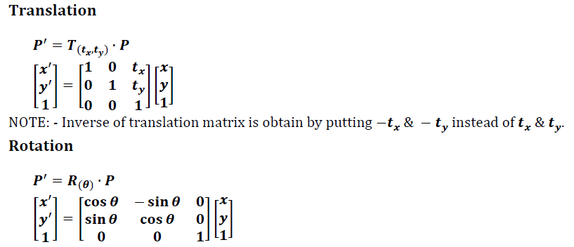
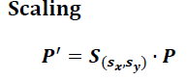
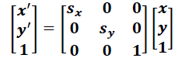
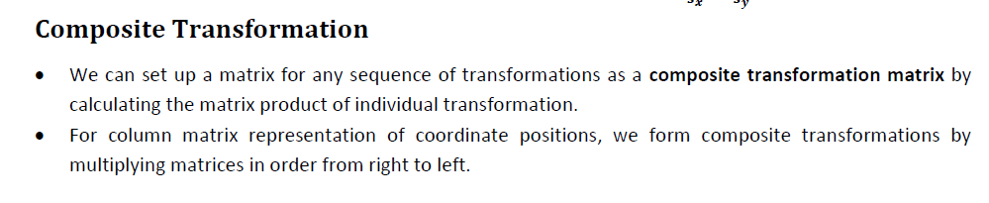

Slide 30
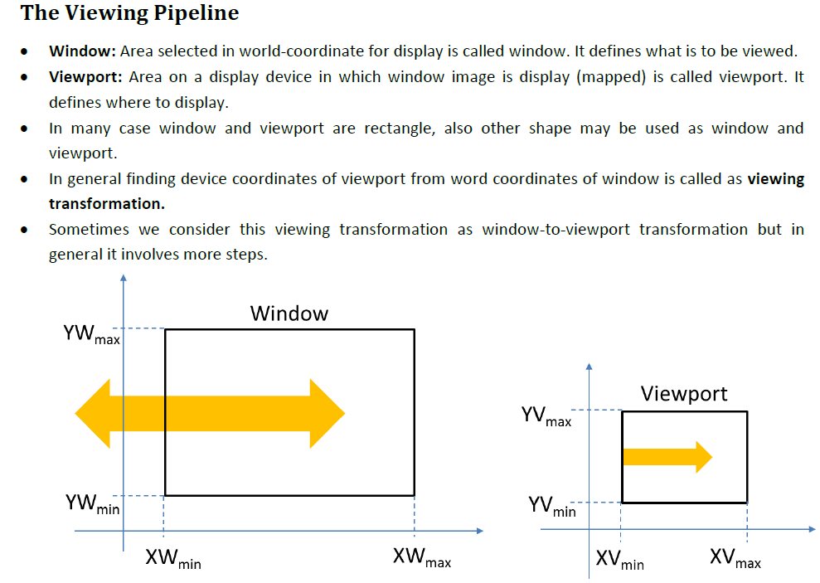

Slide 31
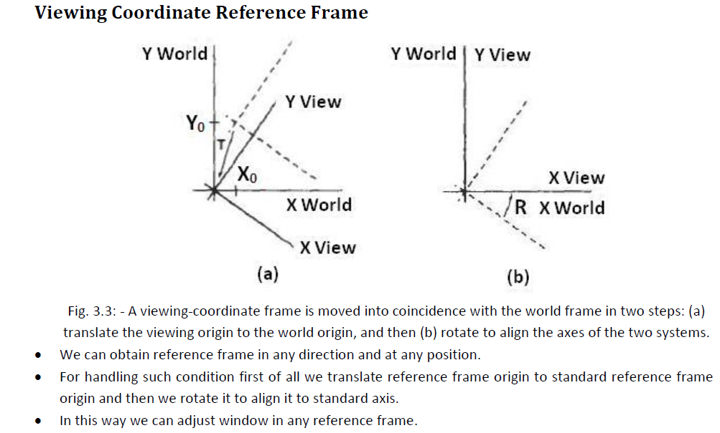
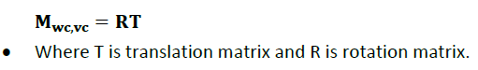

Slide 32
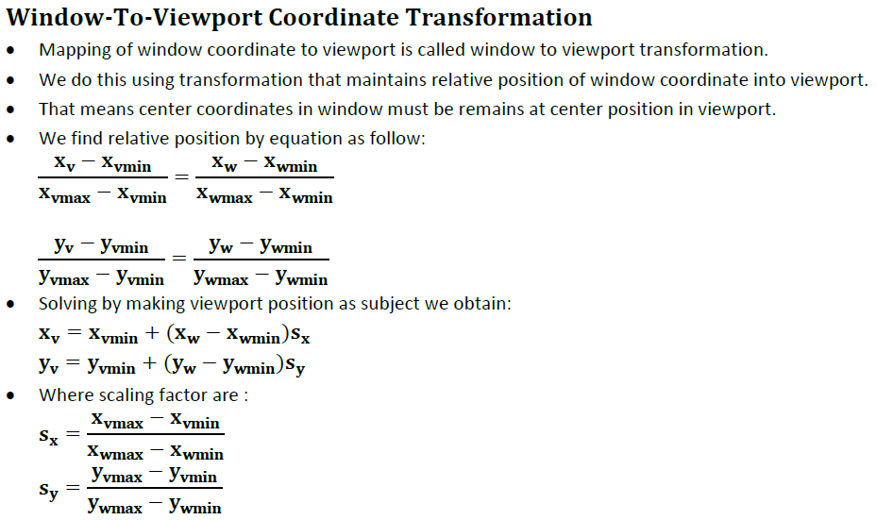

Slide 33
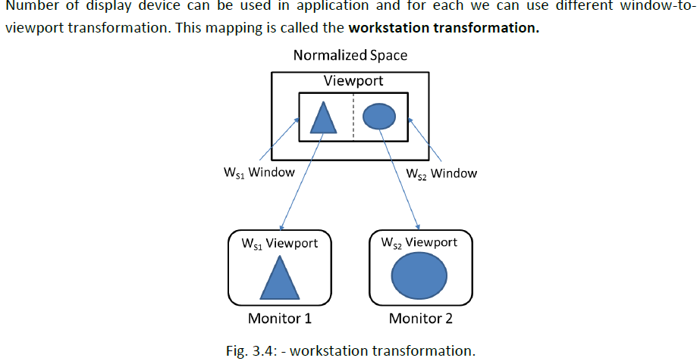

Slide 34
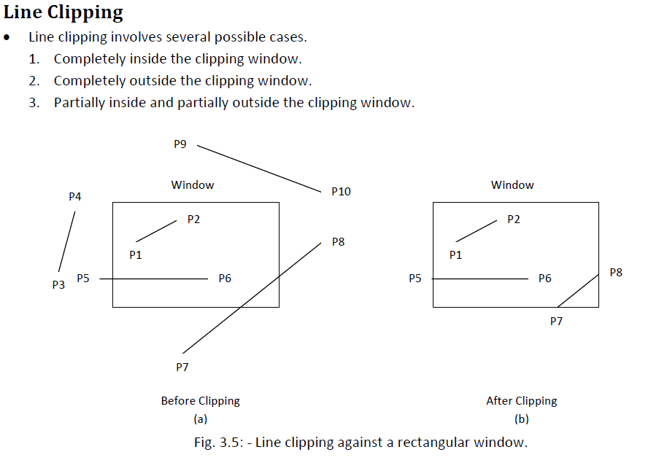

Slide 35
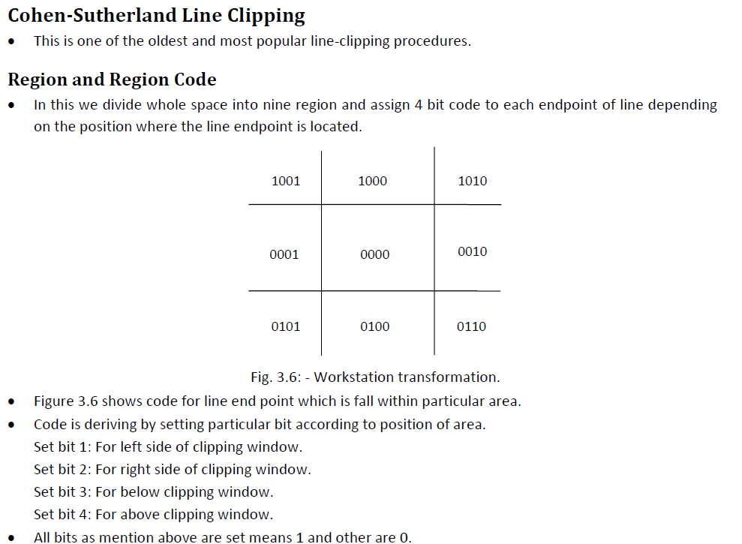

Slide 36
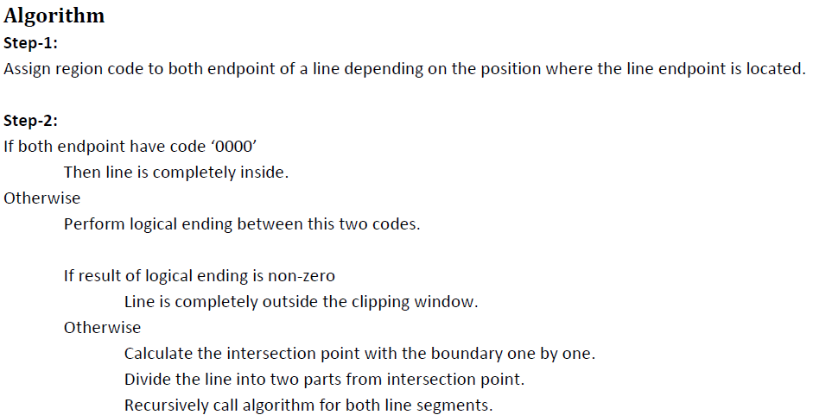
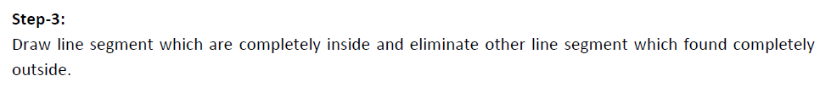

Slide 37
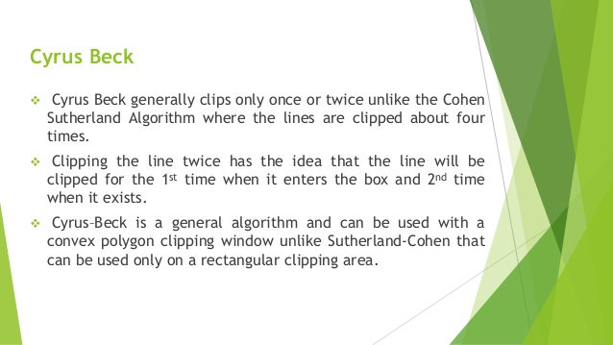

Slide 38
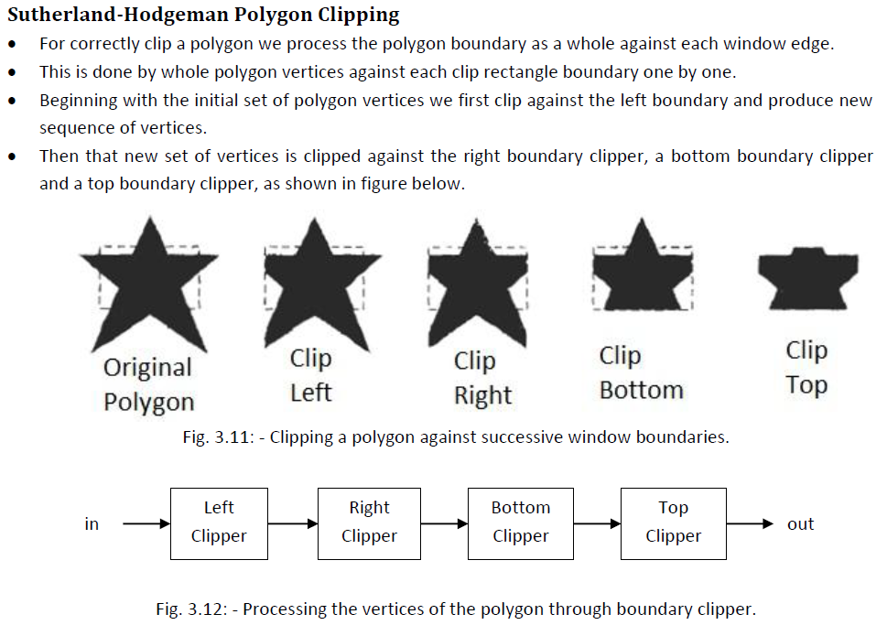

Slide 39
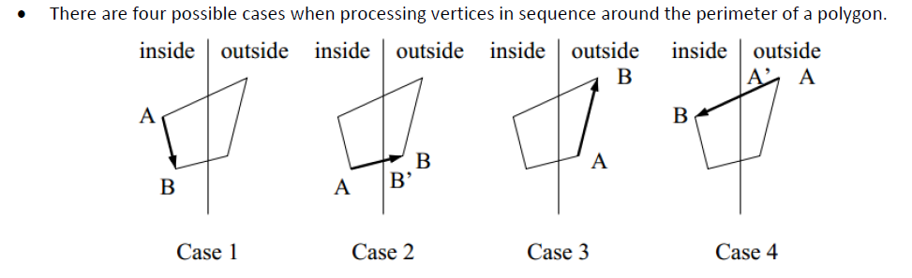
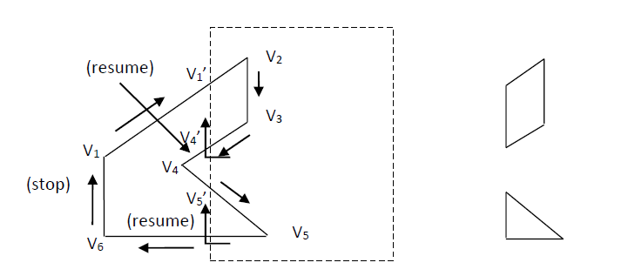

Slide 40
Unit-3

Slide 41
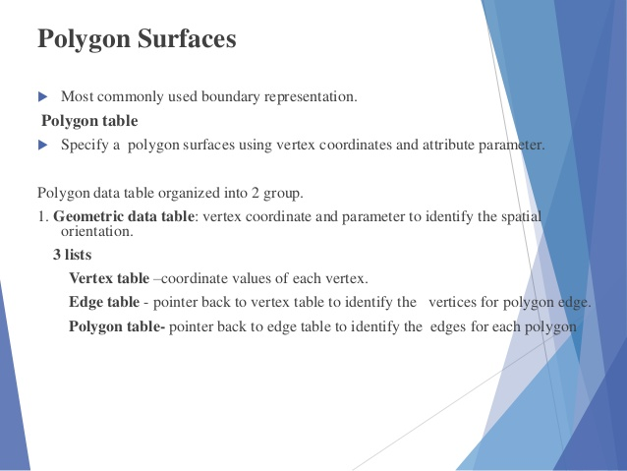

Slide 42
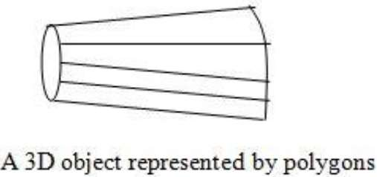

Slide 43
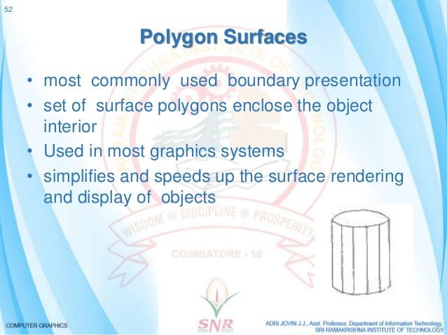

Slide 44
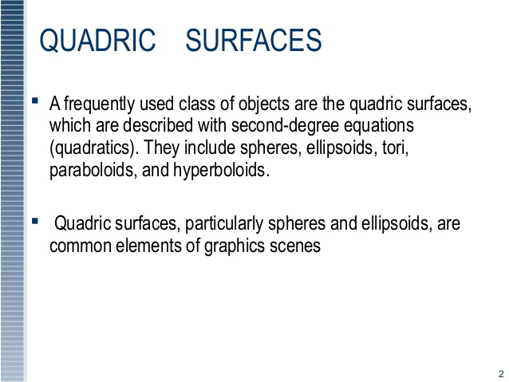

Slide 45
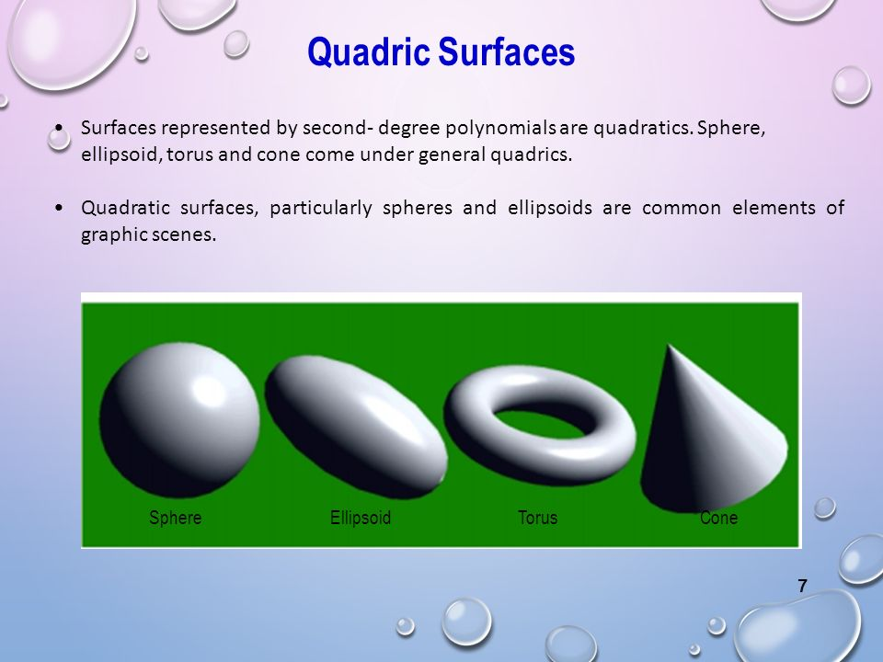

Slide 46
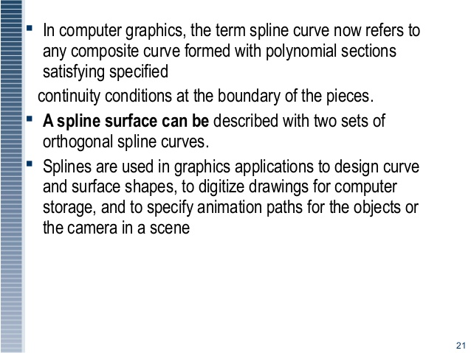

Slide 47


Slide 48


Slide 49


Slide 50


Slide 51
Hermite curve
A Hermite curve is a spline where every piece is a third degree polynomial defined in Hermite form: that is, by its values and initial derivatives at the end points of the equivalent domain interval. Xk+1) individually. The resulting spline become continuous and will have first derivative

Slide 52


Slide 53


Slide 54


Slide 55


Slide 56


Slide 57


Slide 58


Slide 59


Slide 60


Slide 61


Slide 62


Slide 63
Unit-4

Slide 64


Slide 65


Slide 66


Slide 67


Slide 68


Slide 69


Slide 70


Slide 71


Slide 72


Slide 73


Slide 74


Slide 75


Slide 76


Slide 77


Slide 78


Slide 79


Slide 80


